Slide 1
A Prayer for Owen Meany
by John Irving
Notes:
Gold: HTML code: #CABA7B
RGB code: R: 202 G: 186 B: 123
HSV: 47.85° 39.11% 79.22%
Blue: HTML code: #1D88AC
RGB code: R: 29 G: 136 B: 172
HSV: 195.1° 83.14% 67.45%

Slide 2
Audience survey!
Notes:
To start us off, some questions -- raise your hand if:
There are things in your memory that you would rather forget.
You have ever had friends that felt more like family.
You have ever wondered what’s happening with the world.

Slide 3
Plot synopsis + structure
Bildungsroman
Retrospective
Non-linear
Notes:
Genre, plot synopsis, plot structure (+ early arrival spoilers -- plot asks “how?” and “why?” but not “what?”)

Slide 4
Themes
Faith
Fate
Family
Forgetting
Notes:
Thematic statements (lmao I just wanted to make them all rhyme)
Faith: not just in God, but also in society
Fate: prescience, predestination -- Owen is a prophet, but was he reall a self-fulfilling prophecy?
Family: Dickensian; see the podcast
Forgetting/Memory: Bit of a reach! Really about the power of memory, both literal, physical memory and also the memory of the dead

Slide 5
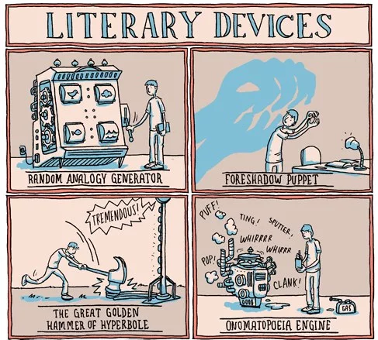
Of note:
Point of view
Motif
Character foils
Notes:
POV: wistful, washed-up Supporting Protagonist (like Scout and Watson)
Motif (messianic archetype/imagery with Owen)
Characterization: Owen isn’t really a person, more of an idea to make wimpy, imperfect Johnny more human (This Loser Is You, drew criticism on Wikipedia page because of that) FOILING

Slide 6
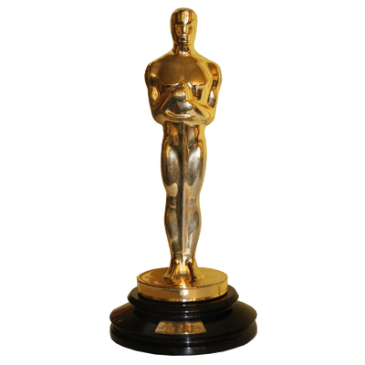
Reception
Considered Irving’s finest
Risky topic
Notes:
Reviews and awards!

Slide 7
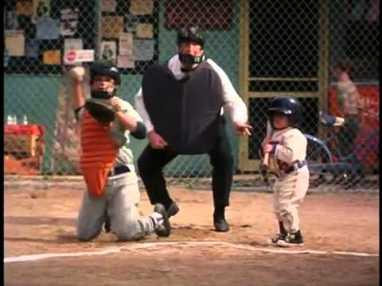
Adaptations
Simon Birch (1998)
“Goodbye Sky Harbour”
Notes:
Awards, pop culture references, adaptations… lead into historical context

Slide 8
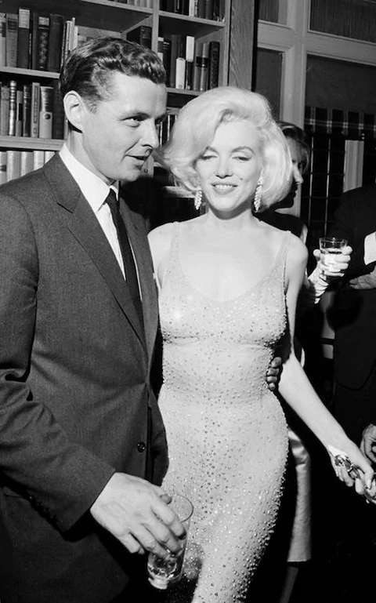
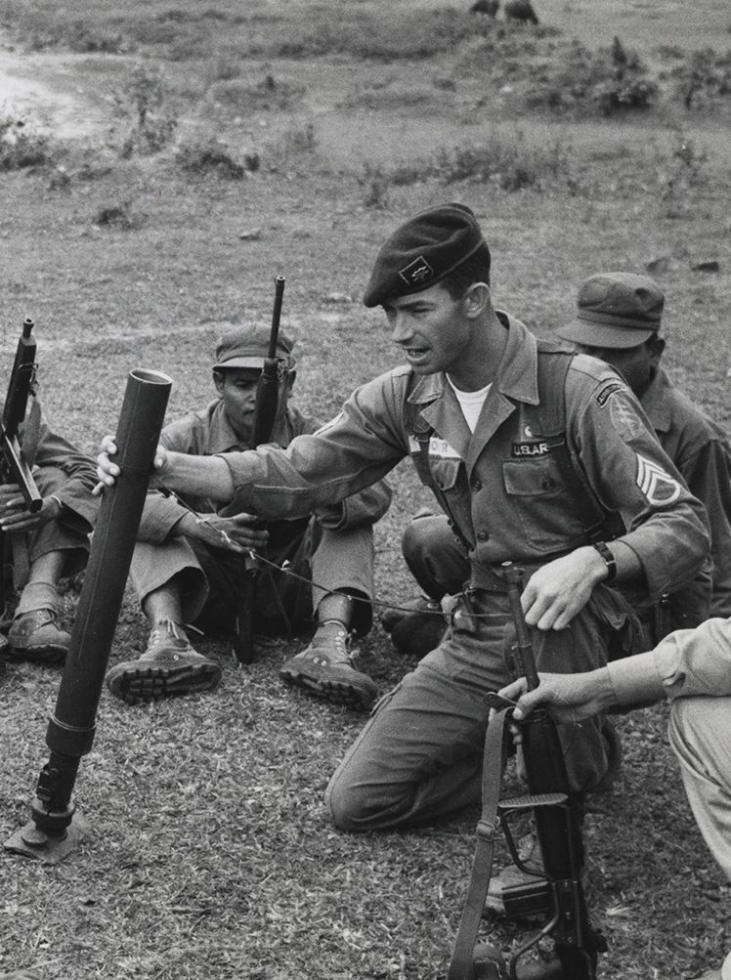
Historical context
Vietnam War
1950s + 1960s America
Notes:
Viet war -- main conflict in-story and also in the generation: vets + coping with trauma using faith or drugs, survivor’s guilt, why did they go? Otherwise doing something drastic to avoid whatever is worse. Saviour complex with colonial nations -- did it actually help at all?

Slide 9
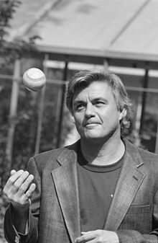
John(ny) Irving
Write who you know
“...what if he didn’t?”
Notes:
Irving’s afterwords! Wanted to connect with a more morbid generation (Wikipedia), wanted to go to Viet for writing experience, but had a kid so he couldn’t go. The inspo for Owen Meany died in Vietnam -- very small boy before http://mentalfloss.com/article/63462/13-facts-about-prayer-owen-meany

Slide 10
In closing...
Surprising
Theatrical
Philosophical
Darkly comic
Notes:
My personal opinions! I grew up religious -- I know why people love it, I know why it sucks. Bit jaded, a little nervous. Kind of a hard sell. What’s funny is that although it’s extremely religious, more than anything it convinced me of the goodness of people? People ARE religion -- for concepts we’re uncertain of, it is what we assume that shapes stuff.
End with a passage that you’ve found already

Slide 11
“I’M ALREADY DEAD!” he told us. “REMEMBER THAT: YOU LET ME DIE.”
Notes:
Finish off with the passage to demonstrate early spoilers

