Slide 1
Editing Your Work English 12 Ms. Dobie

Slide 2
#1. The usual suspects….
1. Indent. Create at least three paragraphs.
2. Invent your title at the end
3. Grab your reader – pull us in.
4. Tell us a story we haven’t already heard.
5. Avoid random capitalization. Spell it correctly!

Slide 3
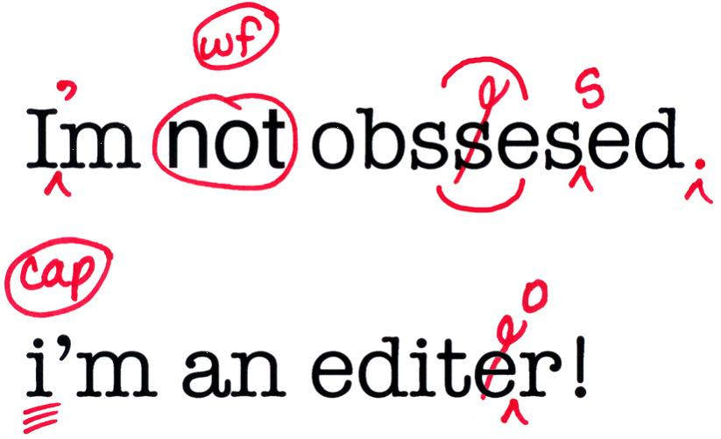

Slide 4
#2. Narrow your focus
In a narrative piece, you need to tell us ONE specific story.
Draw out the details, take the reader by the hand and pull us in.

Slide 5
#3. HOW?
1. Show NOT Tell (Golden Rule)
Do not always tell me that you were feeling tense and nervous – show us.
Do this through a specific example.
* Creative Non-Fiction: May mean that you ‘create’ some details that depart from the actual event. You are given ‘poetic license.’

Slide 6
FIGURATIVE LANGUAGE
METAPHOR
SIMILE
OXYMORON
HYPERBOLE
PERSONIFICATION

Slide 7
#4. USE THE SENSES
Smell, sound, touch, taste, texture.
Example: The night market had lots of great food.
________________________________________________________________________________

Slide 8
#5. Use stream od consciousness
Bring the reader into the moment. Consider the array of sensations a person experiences at the moment.
Inner thoughts (use italics)
Example: I stared at her. Who does she think she is?

Slide 9
B. Bring in the outside environment.
Example: At the moment I could see the dust particles in the air. The room felt stuffy and I knew it was going to be a long two hours before the lecture was over.

Slide 10
Dialogue Make it sound authentic. *how do teens speak?*
Poor: The grade nine kid took off his board, his gray hoody slouched over his head, “ I do hope you have a lovely weekend, my dearest friends.”
Improved: Declan, all 5’ 9“ with his signature goofy braces, took off on his board. His gray hoody slouched over his head – “Later, “ he shouted back at us with his crazy grin.

Slide 11
#6. Use dialogue.
Poor example:
My mom was always scolding me for not getting up early enough.
Improved:
I could hear my mom’s voice as she stomped up the stairs to my bedroom, “ Susan,” she shouted, “for the tenth time GET UP!”

Slide 12
#7. Avoid sounding like bafflegab speak…
Do not disconnect from your experience. Make it sound like a teenager’s experience – not a lawyer or insurance broker’s voice.
Poor: One’s early experiences with failure can have a mitigating influence on life.
Improved: When I saw the tail end of the orange school bus leave for grade 7 camp, I knew I was in trouble.

Slide 13
Know your territory
If you are describing a specific environment, hobby, sport, subject, task, or skill, then use EXACT LEXICON.
Readers like to learn things, so if you are describing an all night session of video games, be specific. Don’t worry that we don’t necessarily get it – use enough to show you AUTHORITY and COMMAND of the subject

Slide 14
Slang expressions/ colloquialisms
TEEN SPEAK 2016
Grade 9’s
- rip
- that’s dope
- 2016 – ‘dab’

Slide 15
Specific lexicon
Activity:
Choose three areas where there is specific terminology or slang expressions:
A. Gaming: ______________________
B. Texting/ social media:_____________________
C. Volleyball:____________________
D. Sailing:_____________________
E. Longboarding:____________________

Slide 16
Use allusions (references to history, pop culture, politics etc.)
Although to much inclusion of allusions can make a piece difficult to read for an outsider, some inclusions can draw us in. Controversial element are welcomed! ☺
Popular culture:
Terms:
Shows:
Singers:
Politics: ie: The Donald

Slide 17
Make it real…
1. Name people ie. My favourite aunt, my classmate Aunty Suzie, Mike C.
Nicknames? Pepper, Dudley, D, J.T.
2. I walked down the street.
I made my way down 41st. As I neared the McDonalds…

Slide 18
Variety

Slide 19
THE HYPHEN -
Reread your piece. Where are the natural breaks?
Pauses give the reader time to digest your images, your ideas.
Consider using the ‘hyphen’ to suggest the pause (rather than using a comma)

Slide 20
Avoid repetitive sentences
POOR EXAMPLE: She walked to the store. She pushed the door open slowly. She looked at the clerk. The clerk was texting.
Improved:
____________________________________________________________________________________________________________________________________________________________________________________________________________________________________________________________________________________________________________

Slide 21
Avoid overloading a sentence.
Example: She picked up the cigarette.
POOR: The old, bent over, wrinkled woman slowed down and leaned over her cane slowly as she picked up the stubby, dirty, smelly cigarette from the littered and rain soaked side walk.
Rework the sentence. Cross out extraneous language that draws attention away from the focus of your description.

Slide 22
How to prevent boredom from setting in…
1. Add variety of sentence length to your piece. Switch it up.
2. Don’t be afraid of ‘prose-poetry’. It’s ok to use one or two words alone even if they do not make a ‘proper sentence’.
Example:
I pushed my way through the crowd – dusk was settling in and the muggy summer air settled over me. Hot. I need to get out.

Slide 23
Avoid overloading…
Rewrite your new, shorter sentence. You must decide what is the FOCAL POINT.
A) the woman
B) the way she bends down
C) the cigarette
D) the street
______________________________________________________________________________________________________________________________

Slide 24
Avoid Repetition
Rule: Avoid using the same word within about four lines before or after.
Student will be expected to make up any missed work. This missed work is important and if it is missed, they may be docked points because if they miss it, they are responsible for it.

Slide 25
Conscious repetition
The clock ticked slowly- one, two, three. It’s small ping counting down the seconds until I could leave this hell: tick, tick, tick.

