Slide 1
Blindness
An exploration of José Saramago’s Blindness

Slide 2
Background
Dystopian, written by Portuguese author José Saramago
Published in 1995 in Portuguese, then English in 1997
Translated by Giovanni Pontiero
Film adaptation in 2008

Slide 3
About the Author
José de Sousa Saramago, born on November 16, 1922
Died at the age of 87 in June of 2010
Winner of the Nobel Prize in Literature in 1998, as well as the Camões Prize in 1995
Widely known for his political satire and unconventional writing style
A self-confessed pessimist
José Saramago

Slide 4
What is “blindness?”
What does it make you think of?

Slide 5
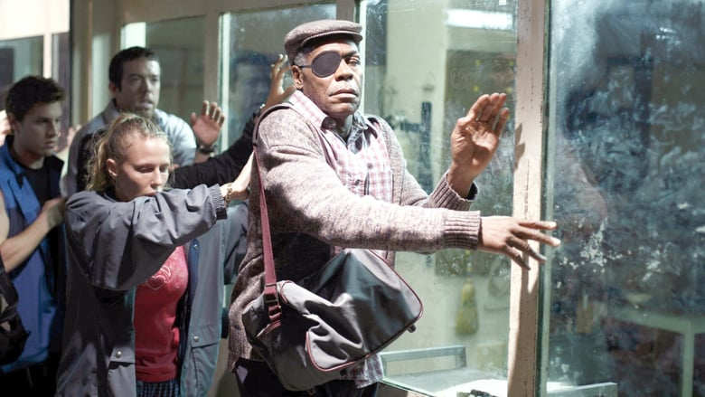
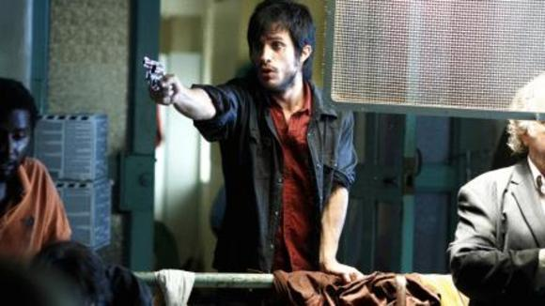
Summary
The world is struck with a sudden plague of “white blindness”
The Government forces the blind into quarantine
The blind internees resort to violence, thievery, deceit, and deception in order to survive

Slide 6
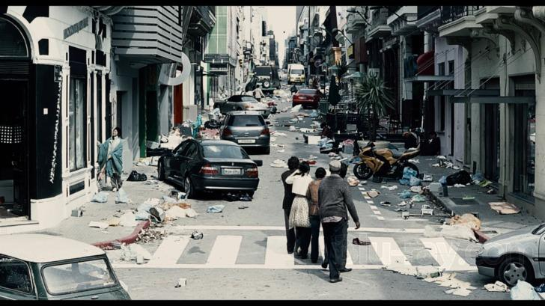

Slide 7
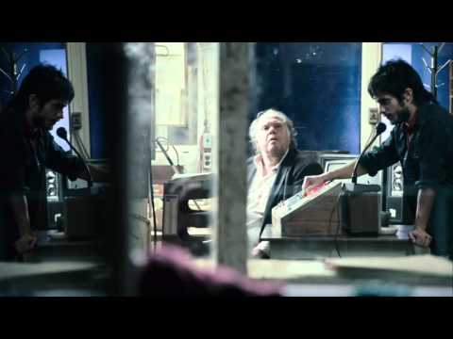

Slide 8
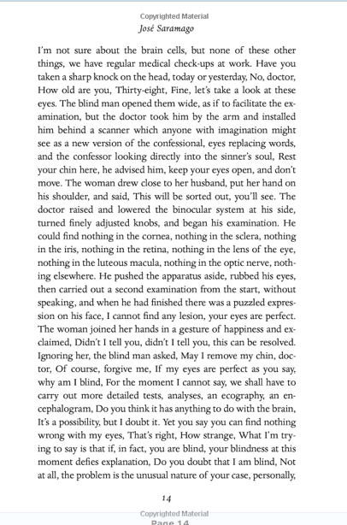
Writing Style
Unique sentence structure
Long, run-on sentences that span paragraphs
Scarce punctuation
Absence of quotation marks, dialogue is separated only by commas and capitalization
Narration
Broad, alternating perspectives of different characters
Lack of individuality
Omniscient narration

Slide 9
What does it all mean?
What is the author trying to convey?

Slide 10
I don’t think we go blind. I think we are blind. Blind but seeing. Blind people who can see, but do not see.
“
”

Slide 11
Analysis
Humanity, and the institutions we create, are metaphorically blind
Morally, emotionally, psychologically, etc.
Our society is fragile
Often victims of our own immorality, cruelty, and inability to understand us and our world

Slide 12
Final Thoughts
Do I recommend this novel?

