Slide 1
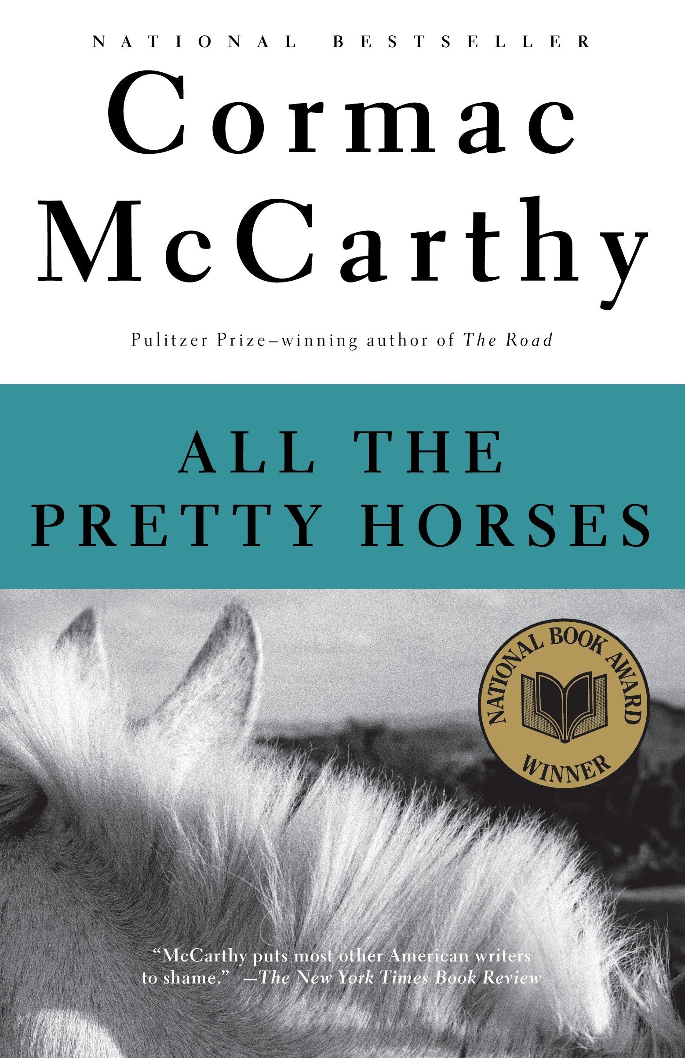
A Look Into Cormac McCarthy’s All the Pretty Horses
Presented by Marcus

Slide 2
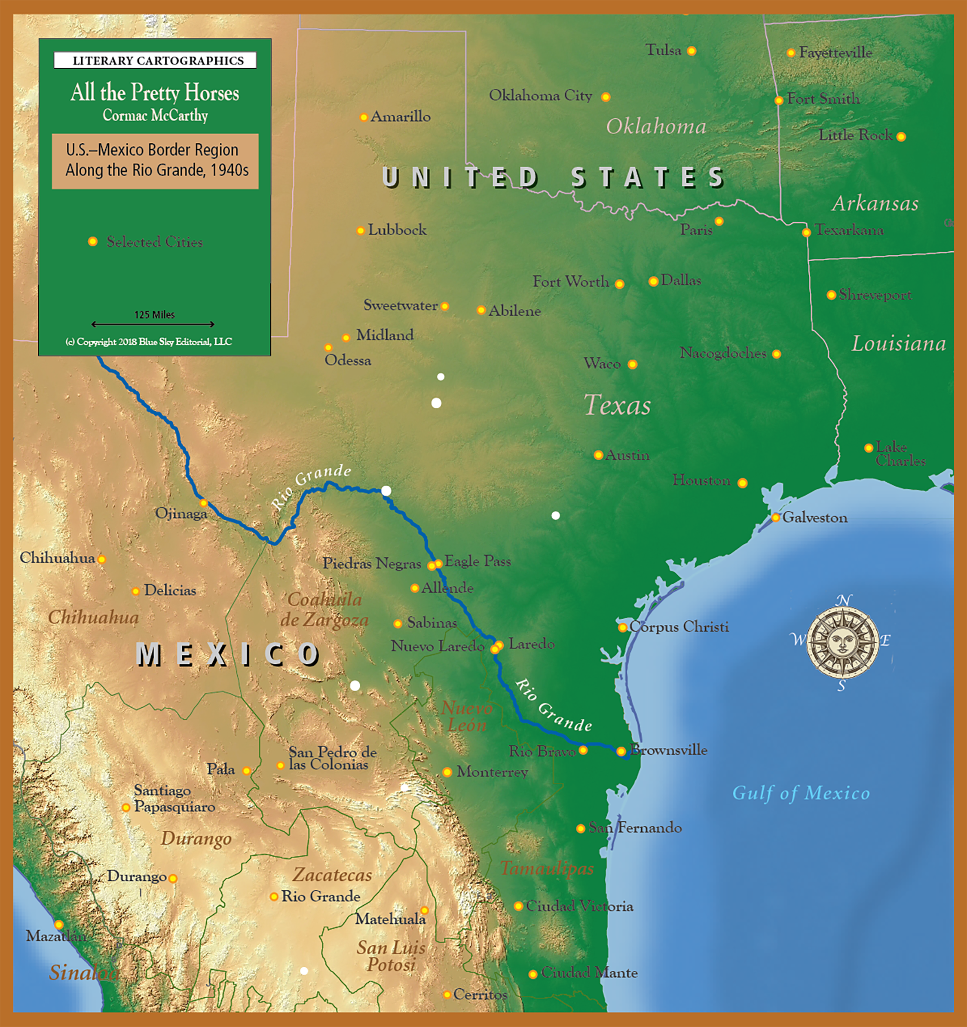
The American Southwest
The Southwest region

Slide 3
Quien es? he said. [Who is it?]
The man swung the light at his feet and ordered him to get his boots and clothes….
Vamonos, said the man. [Let’s go.]
He stood and buttoned his shirt.
Donde estan sus armas? the man said. [Where are your weapons?]
No tengo armas. [I don’t have any weapons.]

Slide 4
Tinaja- a term originating in the American Southwest for surface pockets (depressions) formed in bedrock that occur below waterfalls.
Yucca- a plant with stiff swordlike leaves and spikes of white bell, found especially in warm regions of North America and Mexico.
Arroyo- a steep-sided gully formed by the action of fast-flowing water in an arid region, found chiefly in the southwestern US.

Slide 5
All the Pretty Horses contains many elements of the hero’s journey:
Ordinary World
Call to Adventure
Refusal
Meeting with Mentor
Crossing the Threshold
Tests, Allies, Enemies
Approach to the Inmost Cave
Ordeal
Reward
The Road Back
Resurrection
Return with Elixir

Slide 6
Realism
Idealism
VS

Slide 7
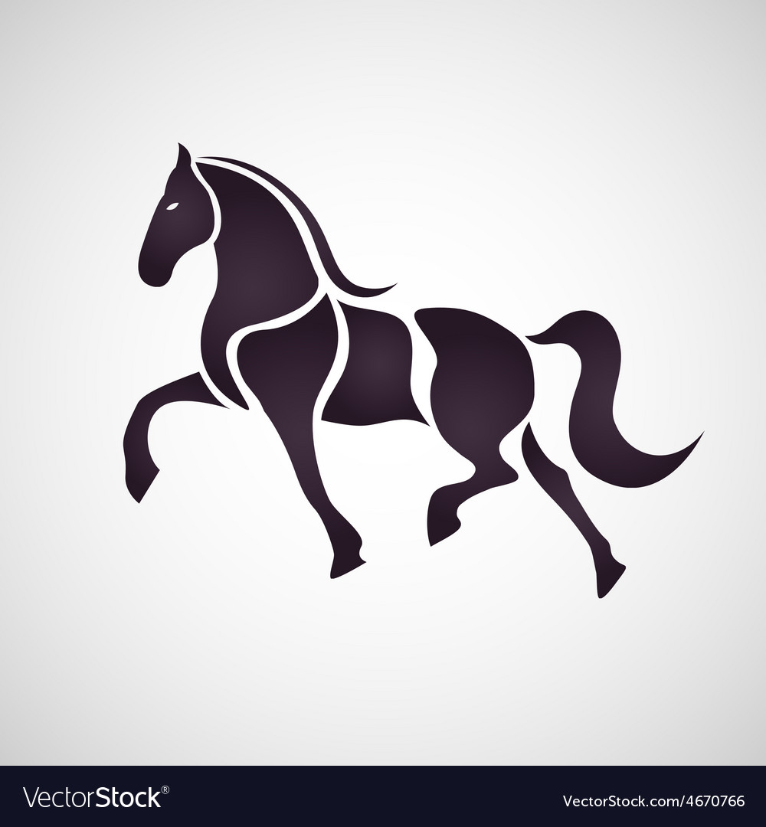
Los Caballos
The Horses

Slide 8
Fate vs Autonomy
Which one leads life?

Slide 9
My father had a great sense of the connectedness of things. I'm not sure I share it. He claimed that the responsibility for a decision could never be abandoned to a blind agency but could only be relegated to human decisions more and more remote from their consequences. The example he gave was of a tossed coin that was at one time a slug in a mint and of the coiner who took that slug from the tray and placed it in the die in one of two ways and from whose act all else followed, cara y cruz (face and cross). No matter through whatever turnings nor how many of them. Till our turn comes at last and our turn passes. -Duena Alfonsa pg. 230-231)

Slide 10
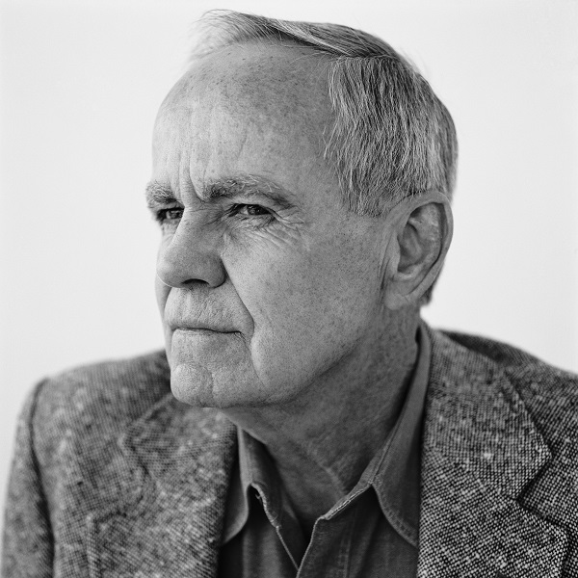
What makes
McCarthy?

Slide 11
You lookin after Rosco good?
He aint been rode.
Why dont we go Saturday.
All right.
You dont have to if you got somethin else to do.
I aint got nothin else to do.
His father smoked, he watched him.
You dont have to if you dont want to, he said.
I want to. Can you and Arturo load and pick me up in town?
Yeah.
What time?
What time'll you be up?
I'll get up.
We'll be there at eight.
I'll be up.

Slide 12
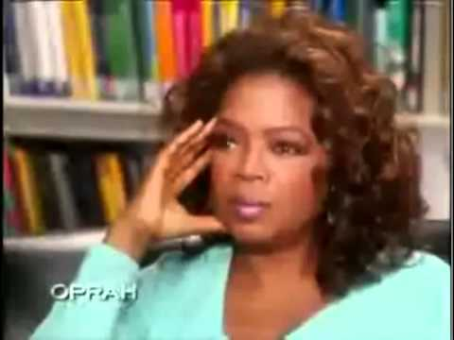

Slide 13
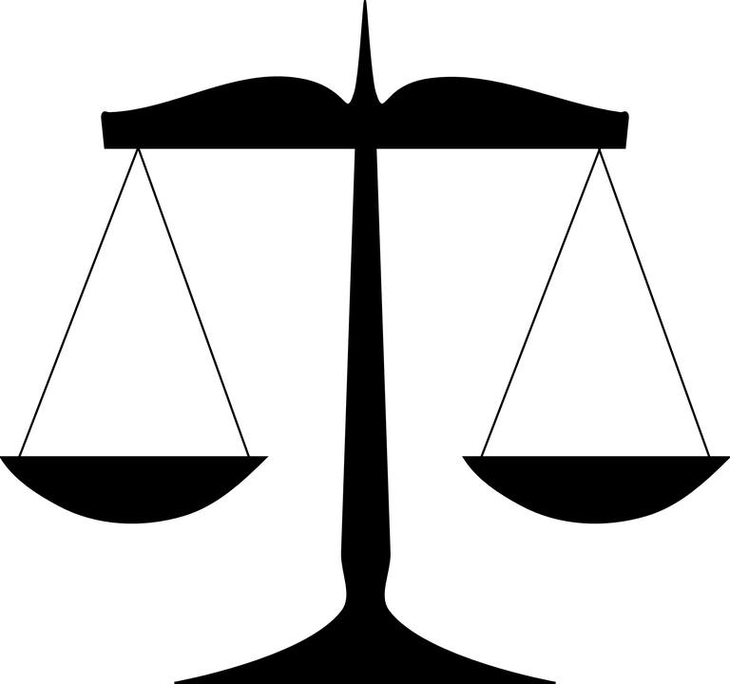
Final Thoughts

